Slide 1
Module 7.3 RSA Public Key Crypto

Slide 2
RSA Public Keys
Named for Ron Rivest, Adi Shamir, and Len Adleman, published in 1978.
Most widely known and used public key system.
No shared secret is required.
Based on some number-theoretic facts/results.
Strength lies in the difficulty of determining the prime factors of a (large) number.
Hardware improvements will not weaken RSA as long as appropriate key lengths are used.

Slide 3
RSA Key Generation
Pick large random primes p,q.
Let p*q = n and φ=(p-1)(q-1).
Choose a random number e such that: 1<e<φ and gcd(e, φ)=1. (relative primes)
Calculate the unique number d such that 1<d<φ and d*e ≡ 1 (mod φ). (d is inverse of e)
The public key is {e,n} and the private key is {d,n}.
The factors p and q may be kept private or destroyed.

Slide 4
Encryption and Decryption
Suppose Alice wants to send a message m to Bob.
Alice computes c = m^{e} mod n, where {e,n} is Bob’s public key.
She sends c to Bob.
To decrypt, Bob computes m = c^{d} mod n, where {d,n} is Bob’s private key.
The mathematical relationship between e and d ensures that Bob correctly recovers m.
Since only Bob knows d, only he can decrypt.

Slide 5
RSA - Authentication
Suppose Alice wants to send a message m to Bob and assure him that the message is indeed from her.
Alice computes signature s = m^{d} mod n, where {d,n} is Alice’s private key.
She sends m and s to Bob.
To verify the signature, Bob computes using {e,n} m = s^{e} mod n and checks that it is recovered.
In practice, RSA is combined with a symmetric key cryptosystem (e.g., DES) to encrypt.
RSA is usually combined with a hash function to sign a message.

Slide 6
Why Does it Work?
It is secure because it is difficult to find φ or d using only e and n. Finding d is equivalent in difficulty to factoring n as p*q.
It is feasible to encrypt and decrypt because:
It is possible to find large primes.
It is possible to find relative primes and their inverses.
Modular exponentiation is feasible.

Slide 7
RSA - Example
Let p = 47 and q = 71
then n = p*q = 3337
(p-1)*(q-1) = 3220 = Φ_{n}
Choose (at random) e = 79 [check using GCD (Greatest Common Divisor) that Φ_{n} and e are relatively prime.]
Compute d = 79⁻¹ mod 3220 = 1019
Private key: {79, 3337}
Public key: {1019, 3337}
Let message m be 6882326879666683.
To encrypt, first break it into blocks < n. [required condition]

Slide 8
RSA - Example (continued)
Let message consists of the following blocks:
688, 232, 687, 966, 668, 003
For the first block
688⁷⁹ mod 3337 = 1570 = c₁
For the entire message we have
1570, 2756, 2091, 2276, 2423, 158
To decrypt first block
1570¹⁰¹⁹ mod 3337 = 688
The rest of the message can be recovered in the same manner.

Slide 9
More on RSA
RSA has been implemented in hardware.
In hardware, RSA is about 1000 times slower than DES.
In software, it is about 100 times slower.
These numbers may change, but RSA can never approach the speed of symmetric algorithms.
RSA encryption goes faster if e is chosen appropriately.
Security of RSA depends on the problem of factoring large numbers. Though it has never been proven that one needs to factor n to calculate m from c and e.
Most public key systems use at least 2048-bit key.

Slide 10
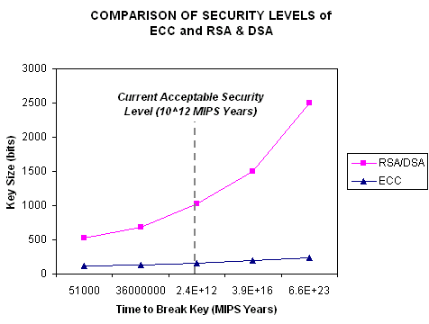
Key Lengths
The longer the key, the longer it takes to do an exhaustive key search. The problem space is to find the private key.
The longer the key, the greater the computational power required to perform cryptographic operations.
This means a tradeoff between security and time/power.
Time and power become important for portable devices (cell phones, smart cards, …).
Popular key lengths:
DES = 56 bits
3-DES = 168 bits
RSA = 2048 bits
ECC < RSA for comparable cryptographic security.

Slide 11
Hybrid Cryptosystems
In practice, public-key cryptography is used to secure and distribute session keys.
These keys are used with symmetric algorithms for communication.
Sender generates a random session key, encrypts it using receiver’s public key and sends it.
Receiver decrypts the message to recover the session key.
Both encrypt/decrypt their communications using the same key.
Key is destroyed in the end.

Slide 12
Digital Envelope
K
M
E_{S}
K_{R(pub)}
K
E_{A}
K is a random session key and E_{s} is a symmetric encryption algorithm and E_{A} is an asymmetric encryption algorithm. The receiver recovers the secret key from the digital envelope using his/her private key. He/she then uses the secret key to decrypt the message.

